Slide 1
Intro to Network Protocols and Wireshark
Notes:
Basic presentation
You likely already know most of this material – it’s mostly to establish a baseline of skills.
With that said, I’ll likely end up demoing at least 1 feature you haven’t seen before.

Slide 2
Agenda
What is a network?
How does data travel over a network?
What is Wireshark?
How can we use Wireshark to analyze network data?

Slide 3
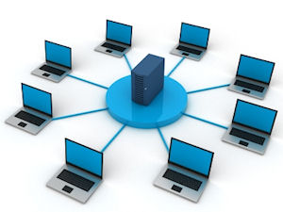
Networks
“A network consists of two or more computers that are linked in order to share resources (such as printers and CDs), exchange files, or allow electronic communications.”
Notes:
Here’s a formal definition of a network.
Simply put, a network is computers connected together.
You can connect computers in many ways – over wifi, satellite, fiber optics, and our favorite, Ethernet.
But please don’t do it like this.

Slide 4
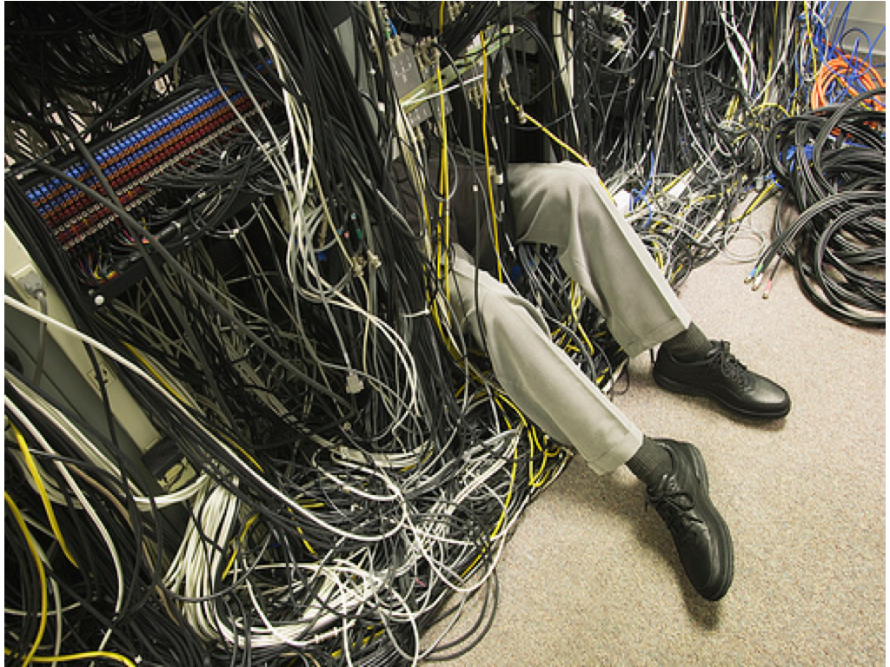
Please not like this

Slide 5
Protocol
A protocol is a series of steps, designed to complete a task.
Computers send each other information using predefined protocols.
Common protocols include IP, TCP, UDP, HTTP, and SMTP
Notes:
Spoiler: The P at the end of each of those stands for protocol

Slide 6
Protocol - Example
Below is a protocol for buying a newspaper:
The customer asks the storekeeper for a newspaper.
The storekeeper gives the customer a newspaper.
The customer gives the storekeeper money.
The storekeeper gives the customer change.
Notes:
The reason this newspaper-buying protocol works is because both sides know exactly which step is next.
I’m sure you’ve seen someone at a store “break” protocol – like slamming their money down on the table and demanding an item. And the resulting shock of all people nearb.
There are a lot of protocols. IETF (Internet Engineering Task Force) calls them “RFCs” (Request for Comments), because that’s how they were originally submitted as proposals.
Unfortunately, that leads to something like this:

Slide 7

Source: https://xkcd.com/927/
Notes:
https://xkcd.com/927/

Slide 8
IP
IP (Internet Protocol) is used to give a unique address to every computer on a network.
IPv4 uses a 32-bit address, split into 4 groups of 8-bit values.
Some examples:
192.168.2.1
10.0.150.126
IPv6 uses a 128-bit address, split into 8 groups of 16-bit values.
Examples:
2001:0db8:0000:0000:0000:ff00:0042:8329
0000:0000:0000:0000:0000:0000:0000:0001
IPv6 addresses are also displayed without intermediate 0’s:
2001:0db8::ff00:0042:8329
::1
Notes:
IPv4 has a max of about 4 billion addresses.
The world has been slowly moving towards ipv6, with the switchover supposedly happening on IPv6 day.
The problem is that ipv6 day was June 8, 2011…. So don’t hold your breath about ipv4 being dropped anytime soon.

Slide 9
TCP
TCP (Transmission Control Protocol) is used to send data from one IP address to another.
TCP and IP are so closely knit that many refer to them as a single entity: TCP/IP.
TCP ensures the transmitted data is:
Received, not missed by the recipient
In correct order, not shuffled
In perfect condition, without modification

Slide 10
TCP (con’t)
How does TCP guarantee data is (a) received, (b) in order, and (c) in perfect condition?
Received: TCP requires an acknowledgement for every single message.
In order: TCP includes a sequence number (message number).
In perfect condition: TCP sends a checksum of the message.
If there is ever an issue, TCP retransmits the message.

Slide 11
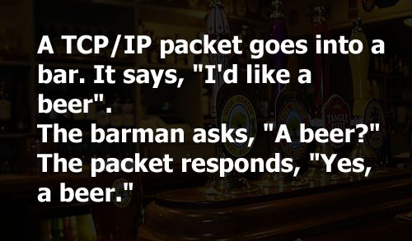
TCP in Action
Notes:
“In high society, TCP is more welcome than UDP. At least it knows a proper handshake”

Slide 12
TCP Fragmentation
TCP packets can only be up to 64KB.
What happens if you need to transfer a large file?
Your computer splits the large file into multiple packets.
It’s like sending a large message over Twitter – you need to split it into a few smaller messages.
Notes:
Ask the audience?

Slide 13
UDP
UDP (User Datagram Protocol) is also used to send data from one IP address to another.
Does NOT guarantee that messages (called datagrams) are (a) received, (b) in order, and (c) in perfect condition.
Why use UDP?
Useful for real-time services (like VoIP) where you’d rather lose some data than have lag.
Notes:
Why UDP?
TCP messages have a lot of overhead, especially on low-quality connections with lots of retransmissions. What if we don’t need TCP’s features?

Slide 14
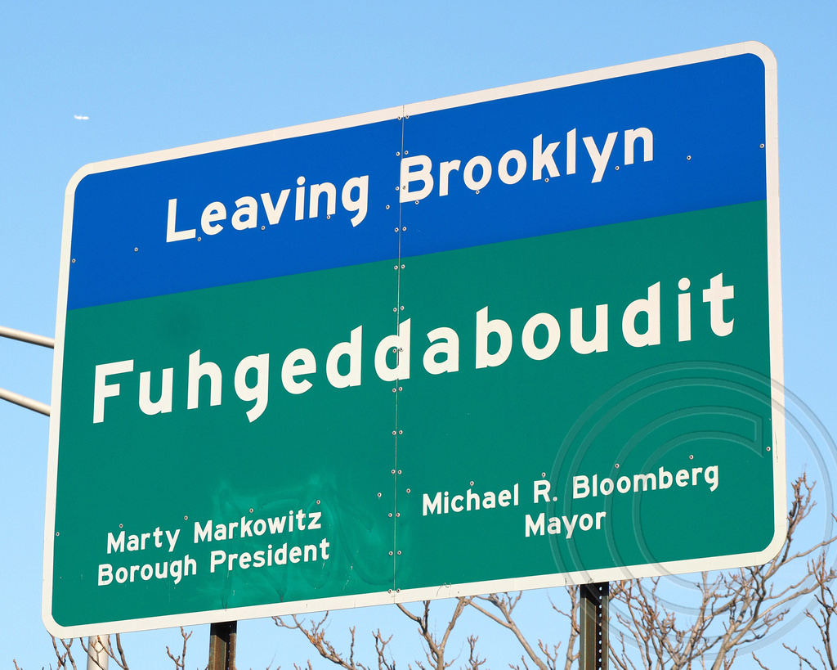
UDP Summarized
“I’d make a UDP joke… but I’m not sure if you’d get it”
Notes:
Fuhgettaboutit
Another line you might hear is: “I’d make a UDP joke… but I’m not sure if you’d get it”

Slide 15
HTTP
HTTP (Hypertext Transfer Protocol) is used for transferring web traffic over TCP.
Already has the guarantee from TCP that the data is (a) received, (b) in order, and (c) in perfect condition.
Web traffic includes webpages (HTML) and other web content (images, audio, video).
HTTP operates with the following two steps:
The client sends a request for a file.
The server replies with a response.

Slide 16
HTTP Request – Details
HTTP Requests consist of a request line and any number of headers.
Request Line:
Request Type
Requested resource
Example Headers:
User-Agent
Referer
Example:
GET /index.html HTTP/1.1
Host: www.example.com
User-Agent: Mozilla/5.0 (Windows NT 6.1; WOW64) AppleWebKit/537.36 (KHTML, like Gecko) Chrome/52.0.2743.116 Safari/537.36
Request type, Resource, Protocol Version
Headers

Slide 17
HTTP Response - Details
HTTP Response
Status Code
Response Headers
Content-Length
Content-Encoding
Response Data

Slide 18
HTTP Response - Example
Protocol Version, Status Code
HTTP/1.1 200 OK
Date: Mon, 23 May 2005 22:38:34 GMT
Content-Type: text/html; charset=UTF-8
Content-Encoding: UTF-8
Content-Length: 138
Last-Modified: Wed, 08 Jan 2003 23:11:55 GMT
Server: Apache/1.3.3.7 (Unix) (Red-Hat/Linux)
Connection: close
<html>
<head>
<title>An Example Page</title>
</head>
<body>
Hello World, this is a very simple HTML document.
</body>
</html>
Headers
Body
Notes:
The first line of a Response message is the Status-Line, consisting of the protocol version followed by a numeric status code and its associated textual phrase
Talk a little about status codes:
200 == good
300 == redirect
400 == Client error
500 == Server error
Which leads to messages like this:

Slide 19
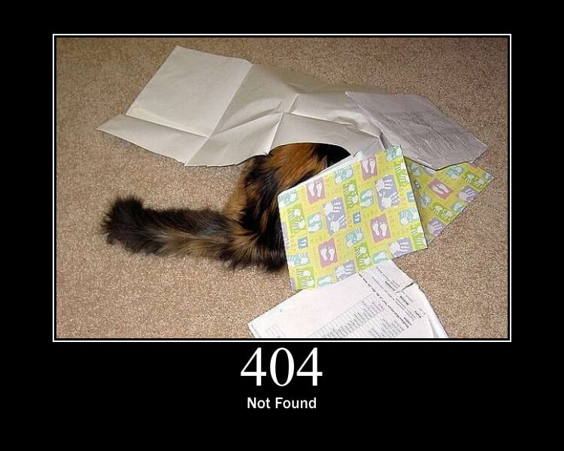
Notes:
404 Page Error – Cat not found
So now, on to the next protocol.

Slide 20
SMTP
SMTP (Simple Mail Transfer Protocol) is used for sending email data.
SMTP is transferred over TCP, so can safely assume the data is (a) received, (b) in order, and (c) in perfect condition.
Email data includes email headers, messages, and attachments.
Notes:
We use SMTP all the time – because we’re constantly getting emails here.
You’ve also probably received an email from this guy:

Slide 21
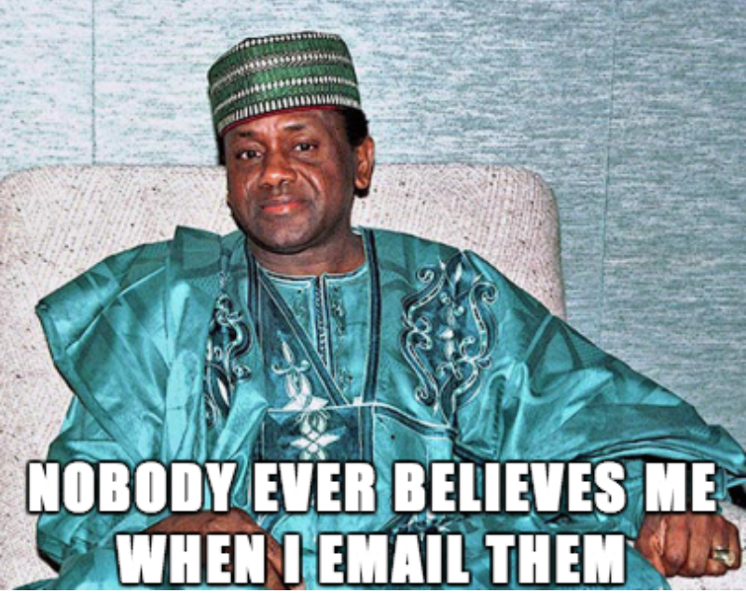
Notes:
I personally don’t feel too bad for him.
We’ve been going over a lot of theory. Let’s go over the practical now:

Slide 22
What is Wireshark?
Wireshark is a packet analyzer, or a tool for analyzing network traffic.
The traffic can be from a packet capture (PCAP) file or straight from your network card.
Wireshark includes dissectors or decoders, for IP, TCP, UDP, HTTP, SMTP, and many other protocols.
Notes:
http://www.howtogeek.com/104278/how-to-use-wireshark-to-capture-filter-and-inspect-packets/

Slide 23
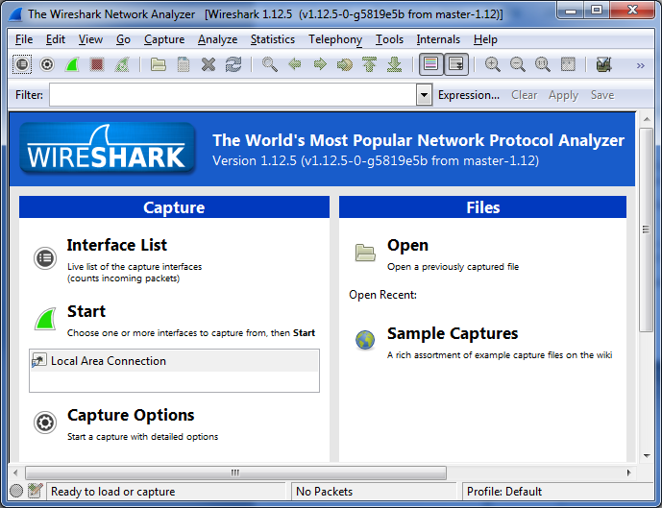

Slide 24
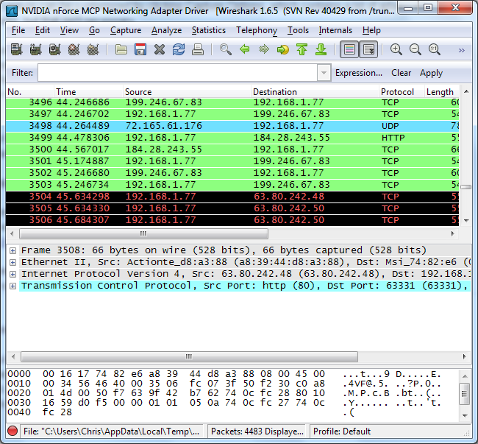
Working with Wireshark
Notes:
You’ll probably see packets highlighted in green, blue, and black.
Wireshark uses colors to help you identify the types of traffic at a glance.
green is TCP traffic
dark blue is DNS traffic
light blue is UDP traffic
black identifies TCP packets with problems — for example, they could have been delivered out-of-order or retransmitted.

Slide 25
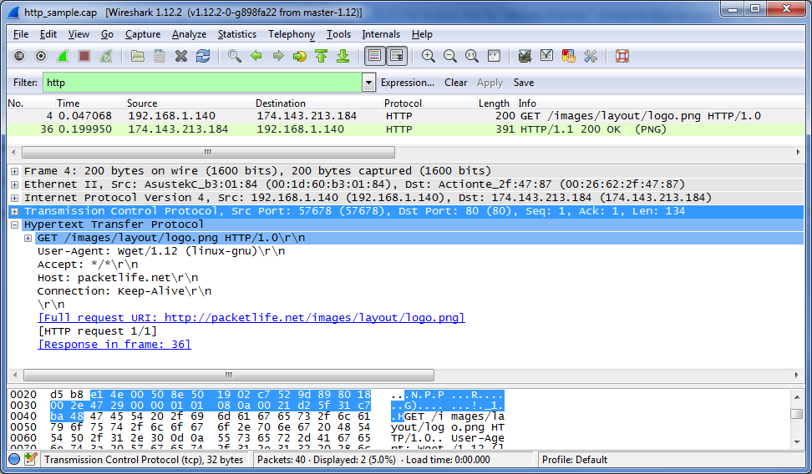
Analyzing HTTP traffic

Slide 26
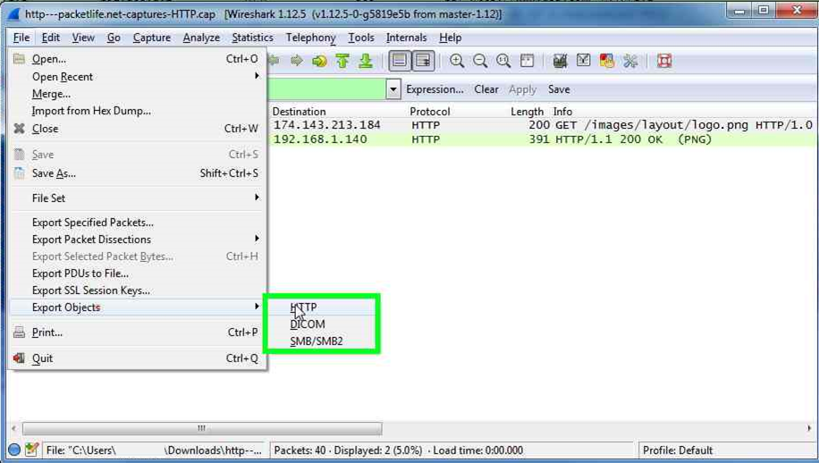
Extracting HTTP Objects

Slide 27
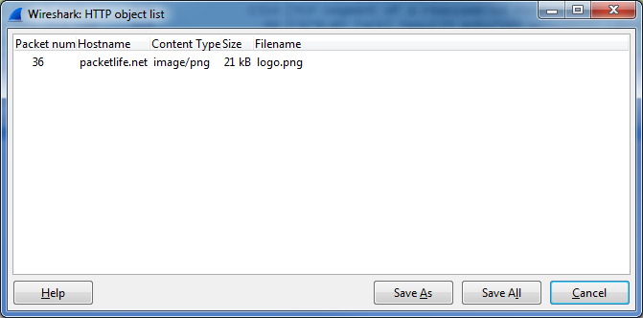
List of HTTP Objects

Slide 28
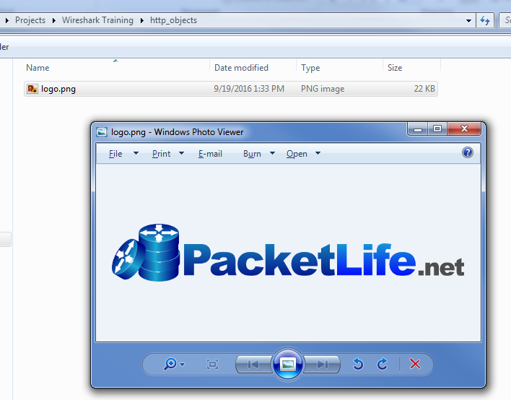
Extracted File

Slide 29
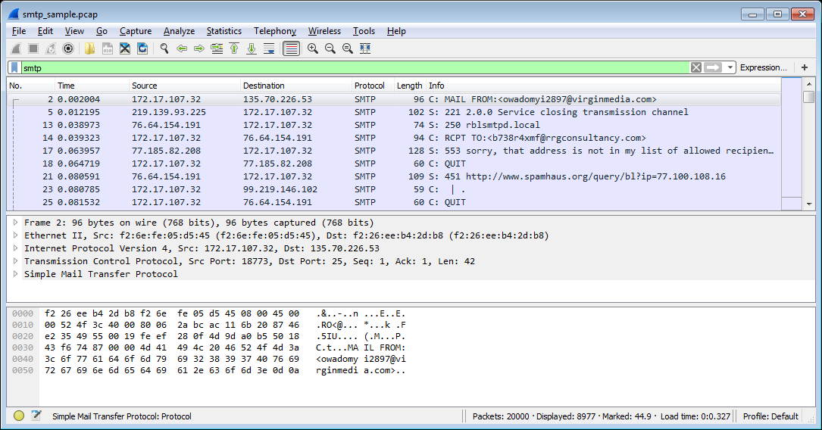
Analyzing SMTP traffic

Slide 30
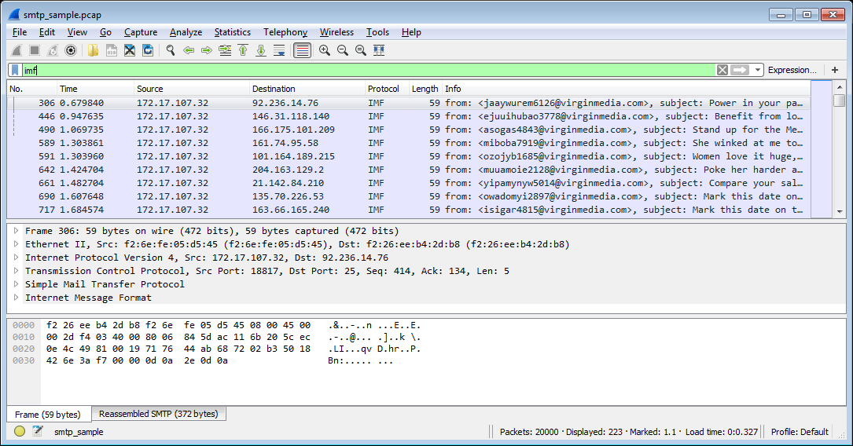
Analyzing SMTP traffic

Slide 31
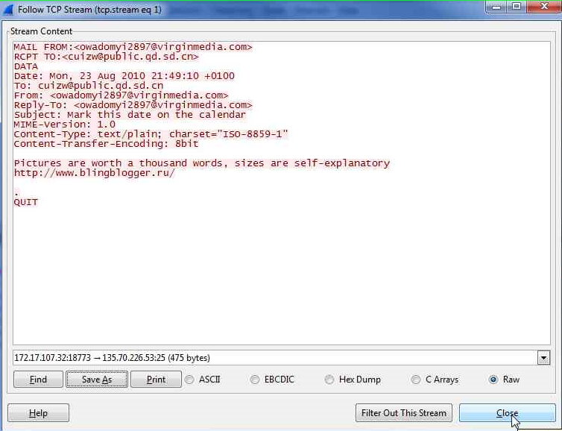

Slide 32
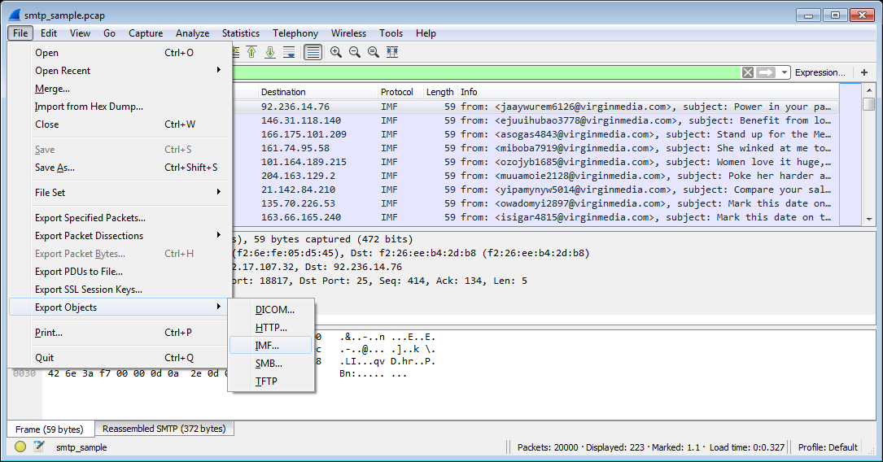
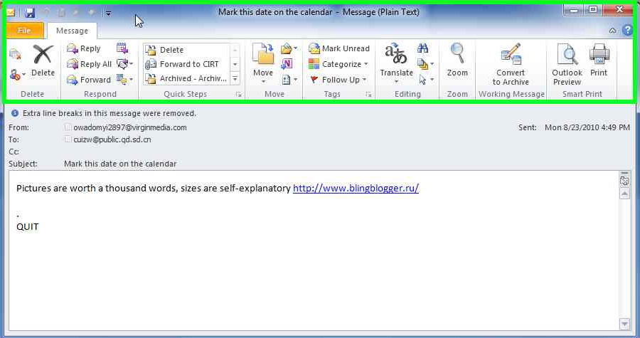
Exporting the EML

Slide 33
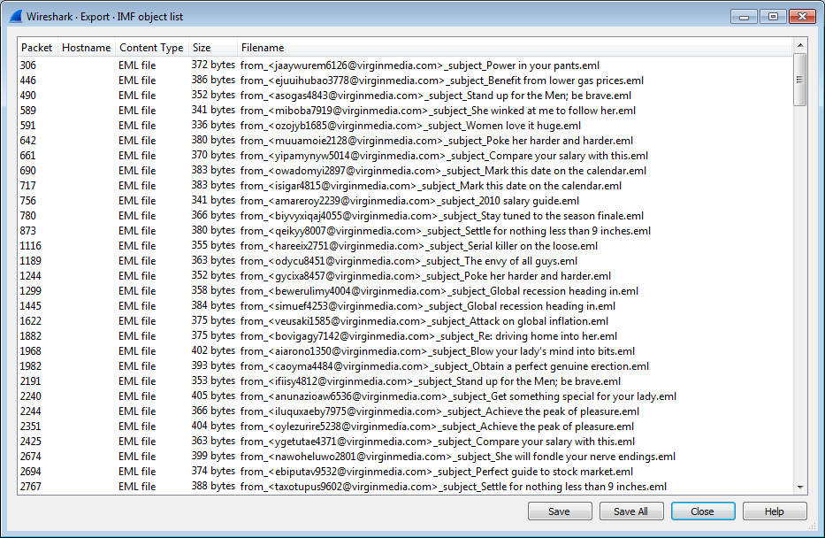
Exporting the EML

Slide 34
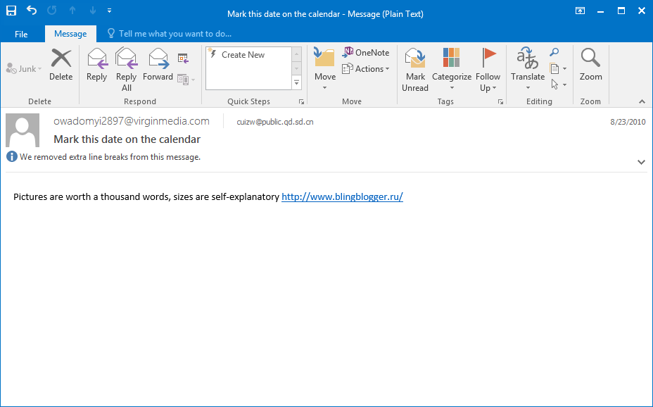
The extracted EML

Slide 35
HTTP Challenge 1
Pico CTF 2014 : Intercepted Post
We intercepted some of your Dad's web activity. Can you get a password from his traffic?
PCAP: intercept.pcap

Slide 36
HTTP Challenge 2
Cyber Security Challenge 2015: Four Eyes
You are a member of a covert agency that is spying on one of their intelligence targets. They have managed to MiTM (Man-in-The-Middle) one of the target employees and are monitoring his HTTP traffic. It is of vital importance that you extract the correct password he submitted to www.2dehands.be.
PCAP: password.pcap

Slide 37
HTTP Challenge 3
IceCTF 2015: SHARKNADO!
We managed to intercept this web traffic, the target was logging on to web2015.icec.tf. can you look into it?
PCAP: sharknado.pcap
Goals:
Which websites did the user visit?
What credentials, if any, were used?

Slide 38
References and Further Reading
Book: Secrets & Lies, Bruce Schneier
Book: Chris Sanders - Practical Packet Analysis
https://fcit.usf.edu/network/chap1/chap1.htm
http://www.joelonsoftware.com/articles/LeakyAbstractions.html
https://www.w3.org/Protocols/rfc2616/rfc2616.html
http://rve.org.uk/dumprequest
https://github.com/ctfs

